Slide 1
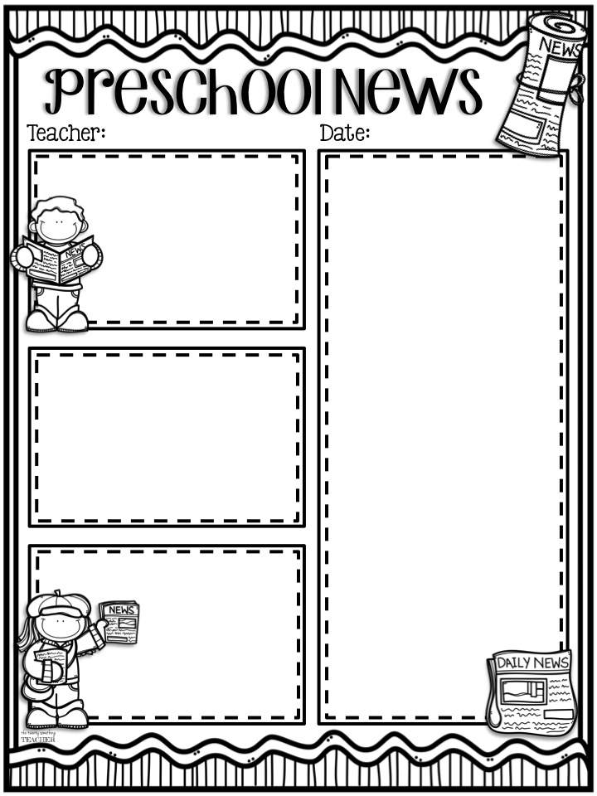
Mrs. Julie Baker
March 15, 2022
Library Day is Thursdays!
Have your child bring their books back
Thursdays to get new books!
Unless we tell you to bring
Your child’s snow gear we
don’t usually have time to go outside. We
do go to the gym at the end of day which
the preschoolers really enjoy!
Hello Parents-
This week in preschool we will be learning about Fish and Letter U.
On Tuesday, the preschoolers will be making a fishbowl with fish inside. We will also be practicing cutting.
On Thursday, the students will be going to the library to pick out books. We will also be doing another page in our ABC book– Letter U. The preschoolers will also be learning about smallest to biggest with a sizes of fish.
Have a wonderful week and please let us know if you have any questions. Mrs. Baker
Bible Verse-
“When I am afraid, I put my trust in you.”
Psalm 56:3 ESV
Bible Stories for the Week-
The preschoolers will be starting there Easter Project this week. Today we will be talking about Jesus coming on a donkey into Jerusalem. On Thursday we will taking about
the Last Supper.
Contact Information:
emails– jbaker@lamontcs.org julesb3396@gmail.com
Phone
School-(616)-677-1757
Cell- (616)-822-8235

