Slide 1
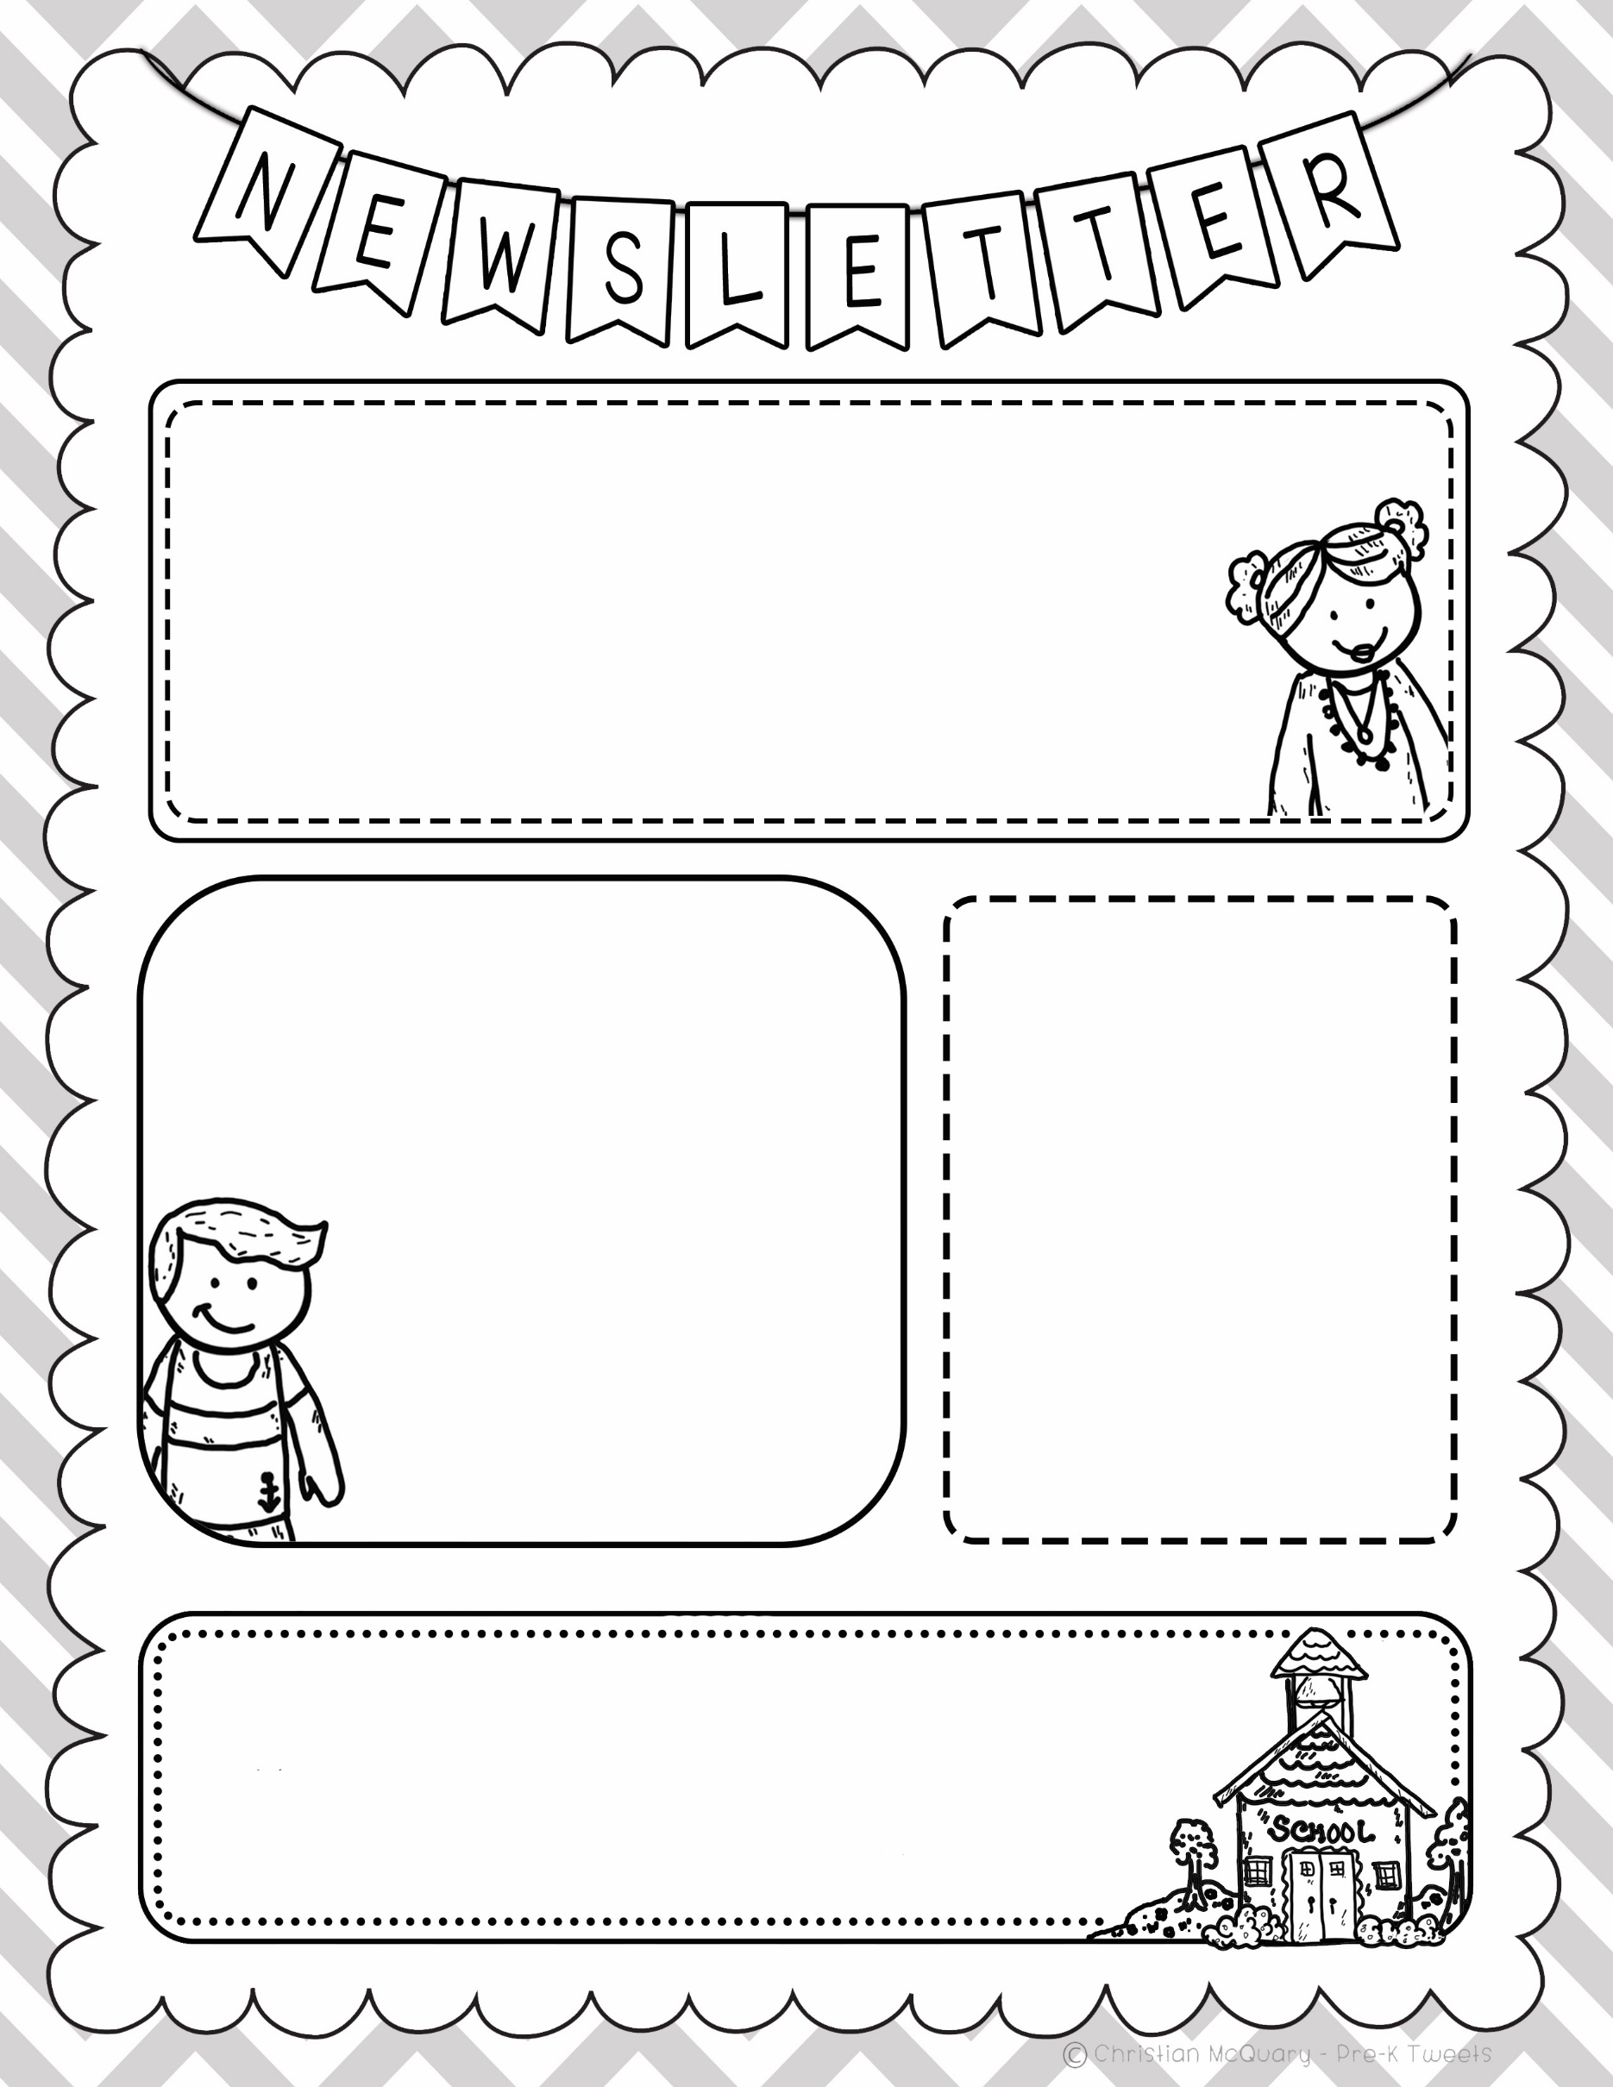
LCS Pre-K
March 14, 2022
Hello Parents, This week in Pre-K we are going to be learning about Birds
On Monday, we will be working on a bird art project to hang in the hallway. We will also be making the first part of a Counting Birds book. On Wednesday, the students will
be learning about letter U and will finishing up the bird project as well as finishing
the number book. On Friday, the Pre-K students will take home the bird project they
started on Wednesday. I am also testing the Pre-K students for conferences at the end of the month. Have a great week!
Blessing Julie and Nicole
Bible Stories
Monday- First Day of Easter Book
Wednesday- Second Day of Easter Book– Jesus
comes in on a donkey
Friday Am – Chapel
Pm- The Story of Jesus and
Bartimaeus
The Pre-K students will be working
on an Easter Book which they will
take home just before Easter.
New Bible Verse:
I have stored up your word in my heart, that I might not sin against you.
Psalm 119:11
Contact Information
jbaker@lamontcs.org--email
616-677-1757– school phone
616-822-8235– Mrs. Baker’s cell phone (I also do text☺)

